Slide 2

Critique du Christianisme de l’Idéologie LGBTQIA+

Slide 3
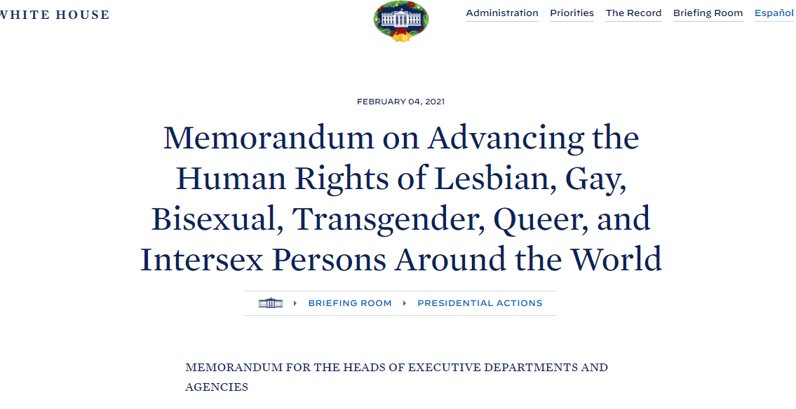

Slide 4
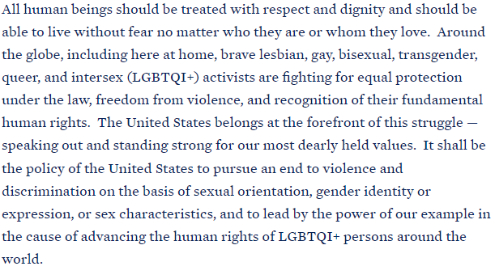

Slide 5
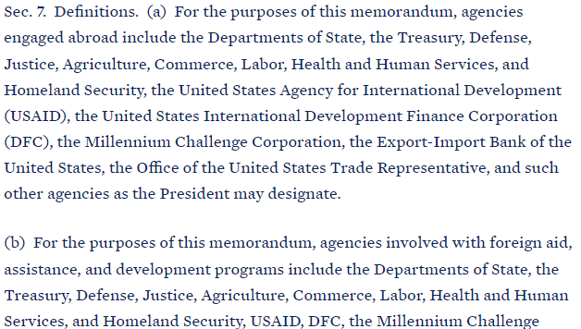

Slide 6
Argument of this presentation
“The LGBTQIA+ ideology to which progressive Christianity conforms is part of an agenda that was not birthed yesterday nor predicted to disappear tomorrow.
As a result, believers in Christ, both individually and collectively, will have to deal with it daily
by holding on to the moral values prescribed in Scripture and establishing guidelines to maintain the holiness of the Body of Christ while pointing the way to hope in Christ until he returns.”

Slide 7

Questions
Where does that come from?
Where is it going?
What can Christians do?

Slide 8




Critique du Christianisme de l’idéologie LGBTQIA+

Slide 9

Where does it come from?

Slide 10
LGBTQIA+ not birthed Yesterday
The quest of the enemy for an ultimate seed
Humanity’s proclivity to alienate from God
Use of palliative solutions when it comes to life eternal

Slide 11
LGBTQIA+ Modern philosophy
Shift of authority from clergy to lay people
Hermeneutical issue of the “death of the author”
Postmodern recourse to palliative solutions

Slide 12
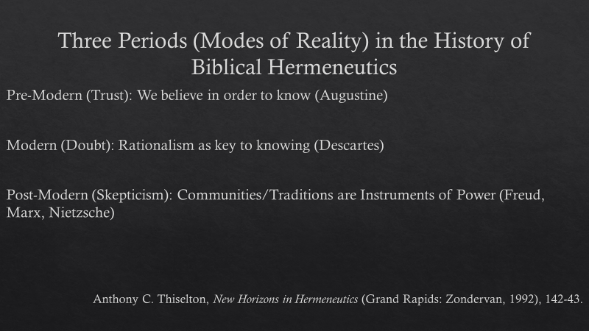

Slide 13
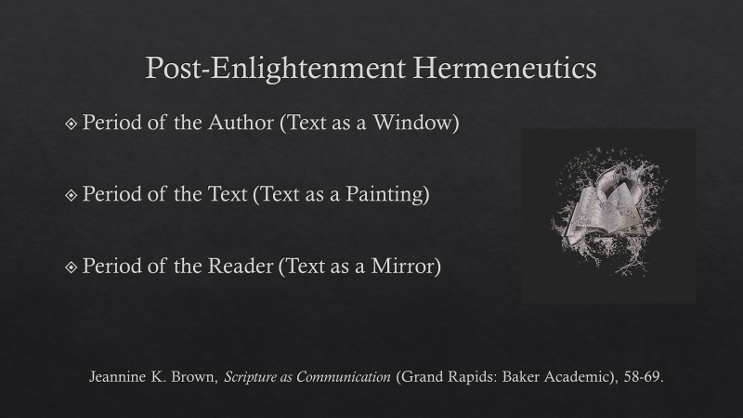

Slide 14

Where is it going?

Slide 15
Where is LGBTQIA+ going?
The narrative
The unspoken
Control of “self”!
Emancipation of “self”!
Freedom from “societal obscurantism”!
subjugation to hidden agenda?
Unconscious enslavement?
Collective subconscious to the puppet master?

Slide 16
LGBTQIA+ is here to stay
In conformity with what Scripture says
  The Story looks forward to a representative of the Serpent (Gen 3.15)
  Bible predicts continuous moral decay ( 2 Tim 3:1-9; Rom 1.24-27)

Slide 17
LGBTQIA+ is here to stay
In conformity with what Scripture says
  “The Bible has lost every major battle it has ever fought. The Bible was quoted to defend slavery and the bible lost. The Bible was quoted to keep women silent, and the Bible lost. And the Bible is being quoted to deny homosexuals their equal rights, and the Bible will lose.”

Slide 18
LGBTQIA+ is here to stay
In conformity with what Scripture says
  “A major function of fundamentalist religion is to bolster deeply insecure and fearful people. This is done by justifying a way of life with all of its defining prejudices… When that Bible is challenged, or relativized, the resulting anger proves the point categorically." John Shelby Spong (2009).”

Slide 19
LGBTQIA+ is here to stay
Homosexuals purpose to make the Bible approve of them
  Leviticus 18: 22 ; 20:13; 1 Cor 6:9; 1 Tim 1:10 were dealing with pederasty, not homosexuality.
  “Man shall not lie with young boys as he does with a woman”
  https://um-insight.net/perspectives/has-%E2%80%9Chomosexual%E2%80%9D-always-been-in-the-bible/

Slide 20
LGBTQIA+ is here to stay
Homosexuals purpose to make the Bible approve of them
  Distinctions of “Gender” is banished in Christ
  “There is neither Jew nor Greek, there is neither slave nor free, there is no male and female, for you are all one in Christ Jesus.” (Gal 3:28)

Slide 21
LGBTQIA+ is here to stay
Homosexuals purpose to make the Bible approve of them
  The case of Ruth and Naomie
  “Jusqu’a ce que la mort nous sépare” (Ruth 1. 16-17)

Slide 22
LGBTQIA+ is here to stay
Homosexuals make the Bible approve of them
  The case of Johnathan and David
  Jonathan l’aima “comme son âme” (1 Sam 18. 1,3)
  Jonathan “prit grand plaisir en David” (1 Sa 19. 1)
  “Ton amour pour moi surpassait celui des femmes” (2 Sa 1.26)

Slide 23
LGBTQIA+ is here to stay
Homosexuals make the Bible approve of them
  The case of the centurion and his servant
  “Mon serviteur est malade” (Mat 8.5-13)

Slide 24

What can we do?

Slide 25
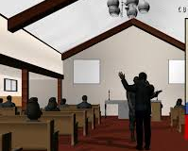
Towards a Christian response
Individual Level
Institutional level

Slide 26
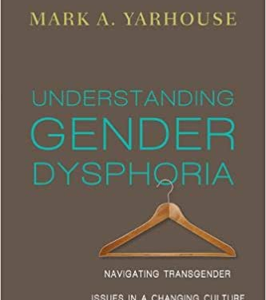

“Puberty suppression”
"Reversible" category: hairstyle, clothing and interest, nickname
"Partially reversible“ category: hormone therapy
"Irreversible" Category: Surgery

Slide 27
Key Milestones of Transgender in Christians
Key step | age | Example
Conscience | 6 | Transvesting behaviour; Atypical game
Internal confusion | 11 | External consequences; Emotional dissonance
Thought/Reasoning | 18 | Sth is wrong with me; Desire to explore
Attempt at a solution | 27 | Counselling Research; Cross-dressing behaviour
Disclosure | 35 | Confide in one’s partner
Resolution | 47 | No resolution; transition; acceptance

Slide 28
Institutional response
Traditional Church
Missional Church
BECOME
BEHAVE
BELIEVE
BELIEVE
BELONG
BELONG

Slide 29

Protective measures for the Church

Slide 30
Quelques mesures de garde-fou
Redaction d’une Charte constitutionnelle de l’Eglise :
Croyances fondamentales
Principes liturgiques
Utilisation des locaux
Provisions disciplinaires
Gestion des litiges engageant:
La congregation et l’Etat
La congregation et ses members
la congregation et ses sympathisants
La congregation et la communaute avoisinante

Slide 31
Quelques mesures de garde-fou
Etablissement des conditions de filiation a l’Eglise:
-Difference entre sympathisants et members
-Services relevant du droit des members
-Services reserves exclusivement aux membres
-Services de bapteme et de Sainte cene
-Les implications de la filiation
-Les etapes conduisant a la filiation

Slide 32
Quelques mesures de garde-fou
Principes pour l’emploi a l’eglise
Principes de recruitment et de transfer/passation de leadership

Slide 33
A few safeguards
Core Beliefs
Liturgical Principles
Use of the church locals
Disciplinary provisions
Management of disputes involving:
The Congregation and the State
The Congregation and its Members
The Congregation and its Supporters
The Congregation and the Surrounding Community

Slide 34
A few safeguards
Establishment of the conditions of filiation to the Church:
-Difference between sympathizers and members
-Services reserved exclusively for members
-Baptism and Sacrament Services
-The implications of filiation
-The steps leading to filiation

Slide 35
Hold on to Christian values
Guard lessons from the non-written revelation
The natural world
The human conscience
Guard lesson from the written Revelation
The Law of Moses proscribes (Lev 18.22; 20.13; 22: 5)
Christ reminds his audience of heterosexuality as God’s design (Mt 19)
Paul indication of God’s judgment (Ro 1.26-27; 1 Co 6.9-11)

